Slide 1
Portfolio Creator CIS434
Team Members: Natalie Tirabassi, Kevin Kiussis, Evelyn Landis, Djesse Jackson

Slide 2
Table of contents
01
02
03
04
05
Introduction
Project Plan
Requirements
Design + Demo
Conclusion

Slide 3
01
Introduction

Slide 4
The purpose is to allow users to create and showcase their personal portfolios with an easy-to-use web application and utilize a user-friendly interface.
Giving users the ability to customize themes/colors of their portfolio, insert projects and links to those projects, and tell more about themselves is the overall scope.

Slide 5
02
Project Plan

Slide 6
Timeline:
Week 1: Requirements gathering and team planning
Week 2: Wireframing and prototype design
Weeks 3–6: Frontend feature development (text boxes, themes, PDF export)
Week 7: Bug fixing, testing across Chrome/Firefox/Edge, final polish
Development Method:
Iterative Development Model with continuous peer review and testing
Front-end only stack (HTML/CSS/JS), no backend or external databases

Slide 7
03
Requirements Specifications

Slide 8

Stakeholders
End Users
Students
Freelancers
Professionals
Instructors

Slide 9
Use Case Example
Actors | User, Web Application UI.
Description | A user fills out their personal and professional details using the provided form fields (e.g., name, contact info, skills, projects). The system collects and stores this data to generate a real-time portfolio preview.
Data | Full name, email, phone number, biography, skills, projects, work experience, education.
Stimulus | User input into the form followed by clicking “Generate Portfolio”.
Response | Portfolio preview is updated in real-time with user-entered data.
Comments | Required fields must be filled and validated before the portfolio can be generated successfully.

Slide 10
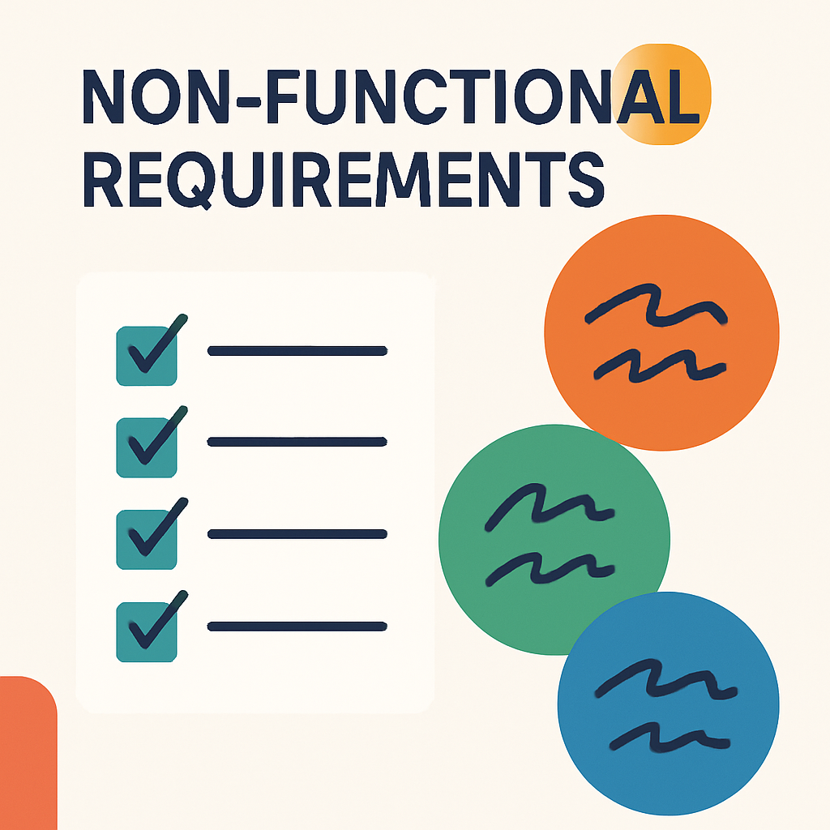
Non- Functional Requirements
Cross-browser compatibility
Offline functionality via local storage
Responsive UI

Slide 11
Development
Style & Architecture

Slide 12

Agile Development approach with weekly check-ups
Software Architecture Pattern:
Event-Driven Architecture pattern
User fills out portfolio form information and selects the generate portfolio button => Portfolio is created which is the event

Slide 13
Testing
All testing was done in the process of the development within VScode
Tests were usually ran after each function to check whether or not it was working as intended
Some test were done after development stage involving netlify to ensure it was properly deployed online.

Slide 14
04
Design + Demo

Slide 15
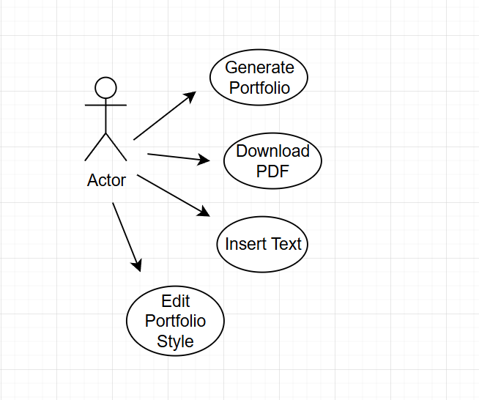
Use Case Diagram

Slide 16
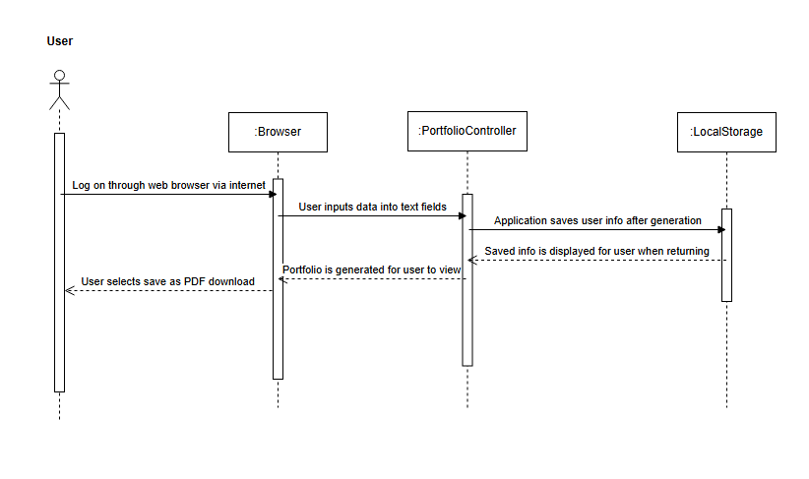
Sequence Diagram

Slide 17
Project Demonstration
https://portfoliogeneratorg15.netlify.app/

Slide 18
05
Conclusion + Future Work

Slide 19

Shortcomings
One feature that we fell short on was fine tuning/fixing the formatting of the exported PDF file.
A more in depth and professional format of the website itself was challenging as we were all somewhat inexperienced with HTML and CSS before this project.

Slide 20

The project successfully met all core goals: user portfolio creation, customization, and export
Testing confirmed functionality across major browsers and screen sizes
User interface is fully responsive and accessible from desktop and mobile devices
Team collaboration and early planning helped prevent major delays or bugs
Future work:
Add user login with backend implementation
Selectable themes/preset customizations
Image insertion

Slide 21
Any questions?

